Slide 1



A Constructicon for Learners of Russian
Laura A. Janda
Tore Nesset
Ekaterina Rakhilina
Olga Lyashevskaya
Francis M. Tyers

Slide 2
Two fundamental claims of construction grammar:
The construction (a form-meaning pairing, at any level of complexity), is the relevant unit of linguistic analysis
A language is an aggregate network of constructions, also known as a “constructicon”
BUT: No complete constructicon has ever been built…
...so we decided to give it a try

Slide 3
The Russian constructicon
Joint project of HSE and UiT
Over 600 entries so far
Part of a multinational project, including English, Brazilian Portuguese, German, Japanese, Swedish
Shared parallel architecture, open-source, free and public
https://spraakbanken.gu.se/karp/#?mode=konstruktikon-rus
Crowdsourcing Googlesheet: https://tinyurl.com/yah8ejlu
Funded by: Norwegian Centre for International Cooperation in Education (2016, 2018-2020), Higher School of Economics in Moscow, and UiT

Slide 4
Priorities of the Russian constructicon
Multiword constructions
At least one “slot” that can be filled with a range of words (semantic restrictions)
Meaning is not necessarily compositional, challenging for L2 learners
Items that are not adequately represented in dictionaries
X так и не Vpast, as in Он так и не женился [He thus and not married] ‘But he didn’t get married after all’
возьми и Vimper, as in А он возьми и купи новую машину! [And he take! and buy! new car] ‘And he went and bought a new car!’

Slide 5
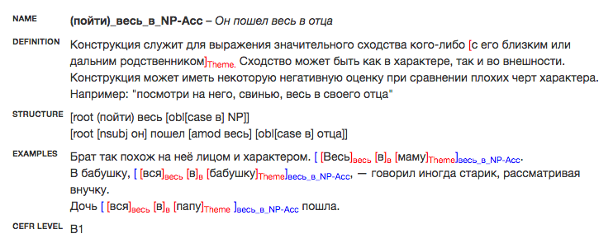
An Entry in the Constructicon ‘he takes after his father’:

Slide 6
An Entry in the Constructicon ‘he takes after his father’:
NAME renders the construction both schematically and with a brief example

Slide 7
DEFINITION explains the meaning of the construction (all definitions will also be translated into English)
An Entry in the Constructicon ‘he took after his father’:

Slide 8
An Entry in the Constructicon ‘he takes after his father’:
STRUCTURE provides a dependency grammar analysis of both the schematic and brief example renderings of the construction

Slide 9
An Entry in the Constructicon ‘he takes after his father’:
At least three corpus EXAMPLES illustrate the construction

Slide 10
An Entry in the Constructicon ‘he takes after his father’:
CEFR is the Common European Framework of Reference for Languages level to guide learners and instructors

Slide 11
Challenges and opportunities in the Russian constructicon
What is a construction? Some things that seem “obviously” compositional to native speakers are “exotic” for L2 speakers
How to classify constructions in terms of semantics, syntax, and lexicon and represent “families” of related constructions
Implementation in teaching and scholarship
Housekeeping: how to establish and maintain order in a creative process

Slide 12
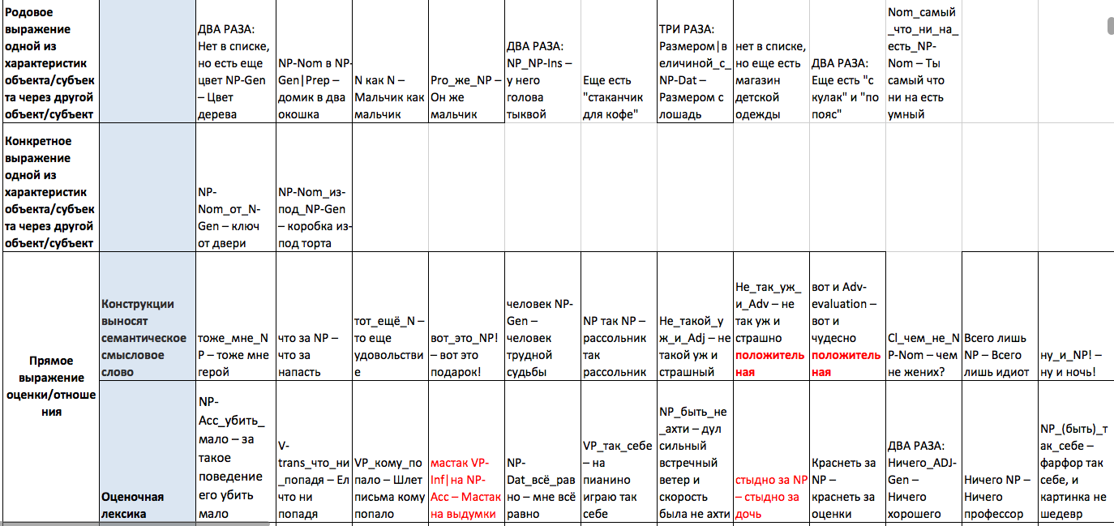
Semantic classification

Slide 13
Semantic classification
generic description of one object by means of another
[house into two windows]
‘a house with two windows’
[he EMPH boy]
‘his is a boy after all’
[size approx. horse]
‘the size of a horse’
[color wood]
‘the color of wood’
[boy like boy]
‘boys will be boys’
[by him head pumpkin]
‘his head is like a pumpkin’
[store children’s clothing]
‘a children’s clothing store’

Slide 14
A familY of constructions related via semantics
(быть)_похож_на_NP-Acc
Вася похож на папу
[Vasja similar on dad]
‘Vasja looks like his dad’
NP-Ins_NP-Nom_в_NP-Acc
лицом она в мать
[face she into mother]
‘in the face she is like her mother’
SIMILARITY
(пойти)_весь_в_NP-Acc
Он пошел весь в отца
[he went all into father]
‘He completely takes after his father’
NP-Nom_(быть)_как_NP-Nom
мальчик был как ангел
[boy was like angel]
‘the boy was like an angel’

Slide 15
Syntactic classification
Inspired by the Russian National Corpus (http://www.ruscorpora.ru/obgrams.html):
complex prepositions (Под_видом_NP-Gen – она приехала в город под видом туриста ‘she came to town under the guise of a tourist’)
adverbial phrases (NP-Nom_без_устали_VP.imp – жена без устали готовила на кухне ‘his wife was tirelessly [without exhaustion] cooking in the kitchen’)
predicative phrases (VP незачем – жить незачем ‘nothing to live for [not-for-nothing]’)
parenthetical expressions (честно говоря ‘to tell the truth [honestly speaking]’)
complex conjunctions (то_ли_XP_то_ли_XP – Сегодня идет то ли дождь, то ли снег ‘Today it is either [then either] raining or [then either] snowing’)
complex particles (нет-нет_да_и_VP – нет-нет да и скажет ‘every once in a while [no-no and and] he’ll say’)

Slide 16
Syntactic classification
Clause: Лишь_бы_VP – Вам лишь бы деньги тратить ‘All you ever do is [you only would] spend money’
Nominal pattern: речь|выступление_перед_NP-Ins – Речь перед враждебно настроенной аудиторией ‘A speech delivered to [in front of] a hostile audience’
Verb pattern: NP-Nom_вести_в_NP-Acc – дверь вела в комнату ‘on the other side of the door there was [the door led into] a room’
Adj: NP_в_NP-Acc – у него была тетрадь в клетку ‘he had a graph paper [into square] notebook’

Slide 17
Syntactic classification
Light verb: NP-Nom_не_преминул_VP-Inf – Он не преминул сделать замечания ‘He didn’t fail [didn’t pass by] to make comments’
Simple (clause): Что_с_NP-Ins? – Что с ним? Почему он плачет? ‘What’s wrong with him [what with him]? Why is he crying?’
Matrix (clause): NP_быть_за_то,_чтобы_Cl – я за то, чтобы ты у нас жил ‘I am in favor of [I am directed behind that] you staying with us’
Biclausal /Parataxis: рассказывай_Cl – рассказывай, не было денег! ‘don’t try to tell me that [tell!] you were out of money!’

Slide 18
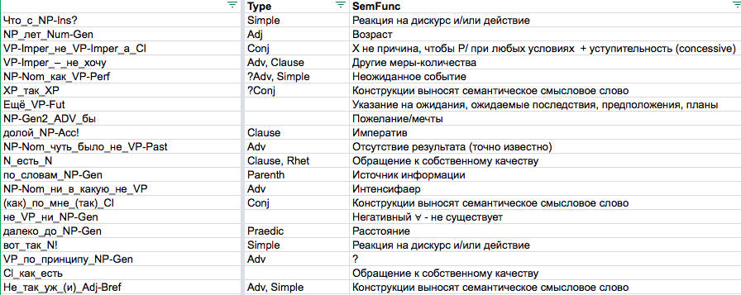
Syntactic classification

Slide 19
A familY of constructions related via syntax
NP_обернуться_NP-Ins
Дело обернулось бедой
‘Things turned sour’
NP-Nom_сделаться_NP/Adj-Ins
Он сделался важным начальником
‘He became a big boss’
NP_отличаться_NP-Ins
Он отличается большой выносливостью
‘He’s remarkable for his stamina’
NP-Nom_начинать_NP-Ins
Он начинал учителем
‘He started out as a teacher’
NP-Nom_числиться_NP-Ins|Adj-Ins
Он числился отстающим в классе
‘He was behind the others in his class’
NP-Nom VP NP-Ins
NP-Nom_пере-VP-ся_NP-Ins
Они перекидываются шутками
‘They are peppering each other with jokes’
NP-Nom_слыть_NP-Ins/Adj-Ins
Она слыла отличницей
‘She was famously brilliant’
NP-Nom_VP_NP-Ins(plural)_NP-Acc
Она скупала мешками картошку в магазине
‘She bought potatoes by the bagful at the store’
NP-Nom_приходиться_NP-Dat_NP-Ins
этот мальчик приходится мне сыном
‘this boy is actually my son’

Slide 20
A familY of constructions related via syntax
NP_обернуться_NP-Ins
Дело обернулось бедой
‘Things turned sour’
NP-Nom_сделаться_NP/Adj-Ins
Он сделался важным начальником
‘He became a big boss’
NP_отличаться_NP-Ins
Он отличается большой выносливостью
‘He’s remarkable for his stamina’
NP-Nom_начинать_NP-Ins
Он начинал учителем
‘He started out as a teacher’
NP-Nom_числиться_NP-Ins|Adj-Ins
Он числился отстающим в классе
‘He was behind the others in his class’
NP-Nom VP NP-Ins
NP-Nom_пере-VP-ся_NP-Ins
Они перекидываются шутками
‘They are peppering each other with jokes’
NP-Nom_слыть_NP-Ins/Adj-Ins
Она слыла отличницей
‘She was famously brilliant’
NP-Nom_VP_NP-Ins(plural)_NP-Acc
Она скупала мешками картошку в магазине
‘She bought potatoes by the bagful at the store’
NP-Nom_приходиться_NP-Dat_NP-Ins
этот мальчик приходится мне сыном
‘this boy is actually my son’

Slide 21
A familY of constructions related via Lexicon
(не)_время_VP-Inf
Самое время вершить большие дела.
‘It’s high time to take on important matters’
время_NP-Gen_(не)_пришло
время серьезного разговора пришло
‘the time has come for a serious conversation’
Anchor word: время
‘time’
время_NP-Gen_прошло
время сомнений прошло
‘the time for doubts is over’
NP-Nom_VP_в_то_время_как_Cl
она пришла в то время как он уходил
‘she came at the same time that he left’

Slide 22
What’s Next: Strategic Mastery of Russian Tool
By 2020, SMARTool will have:
Filters that present the most important frequency-ranked Russian wordforms for CEFR A1-2 and B1-2 levels
Every wordform entry will be supplied with the grammatical constructions that typify its use, sourced from the Russian Constructicon
Collocations in which the wordform typically appears
3000 wordform entries (500 for each of levels A1-2 and 1000 for each of levels B1-2)

